Slide 1
Machine-Learned Piezoresistive Sensors for Bilingual Sign Language Recognition
Student: Toby Bunn
Supervisor: Professor Manish Tiwari

Slide 2
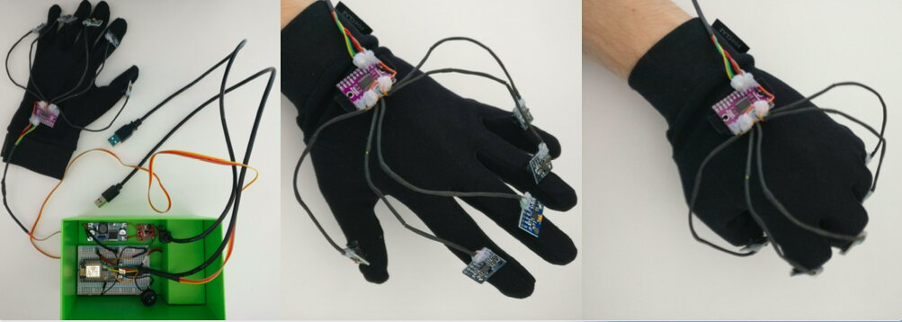
Problem
Sundaram et al., 2019
Fadelli, 2021
Key Problems with Current Research
Cost
Reproducibility
Fabrication Time
Usability
Notes:
stuff exists, citing two sources from MIT and wave glove
Lack of use of strain sensors
Also main issues for wider use like cost, reproducibility

Slide 3



Project Plan and Aim
Experimental
- Develop two new strain sensor types against a commercial sensor for comparison.
Computational
- Utilise supervised machine learning to analyse the sensors capabilities for detecting sign language gestures.
Overall Aim: Find new strain sensors that are feasible for gesture recognition purposes and that fix gaps in current research.

Slide 4
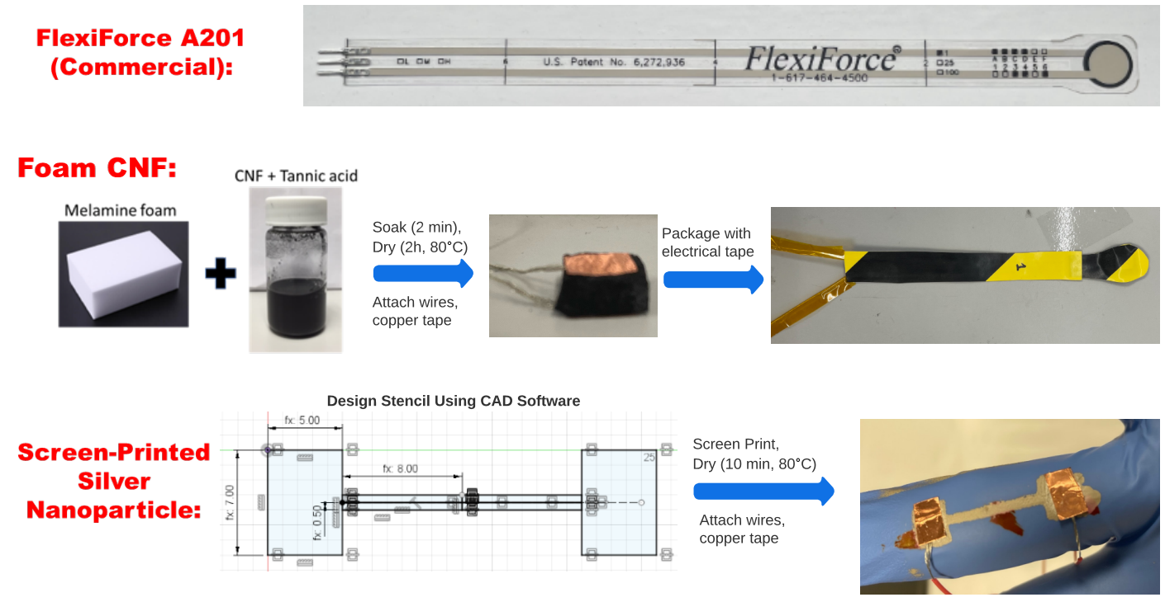
Sensors Used and Fabrication

Slide 5
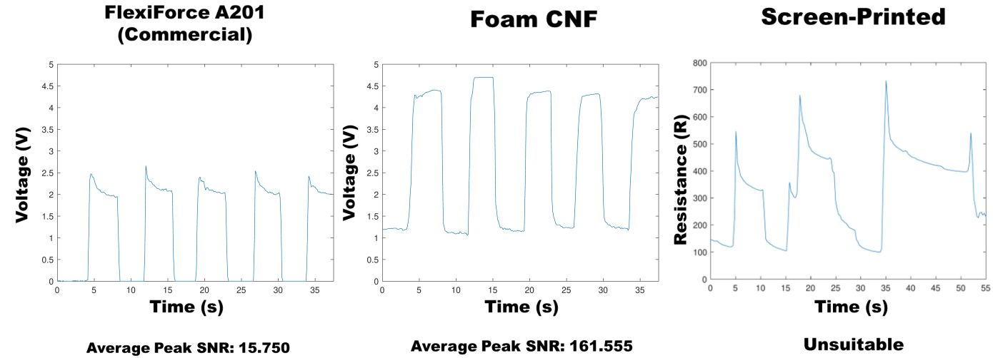
Experimental Tests and Results

Slide 6
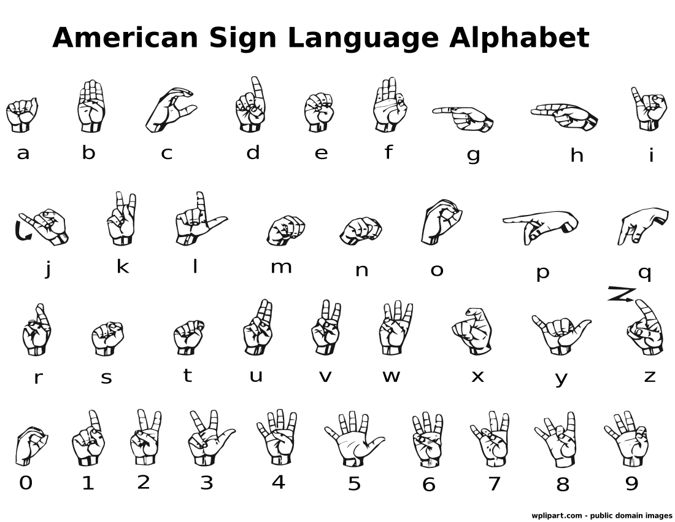
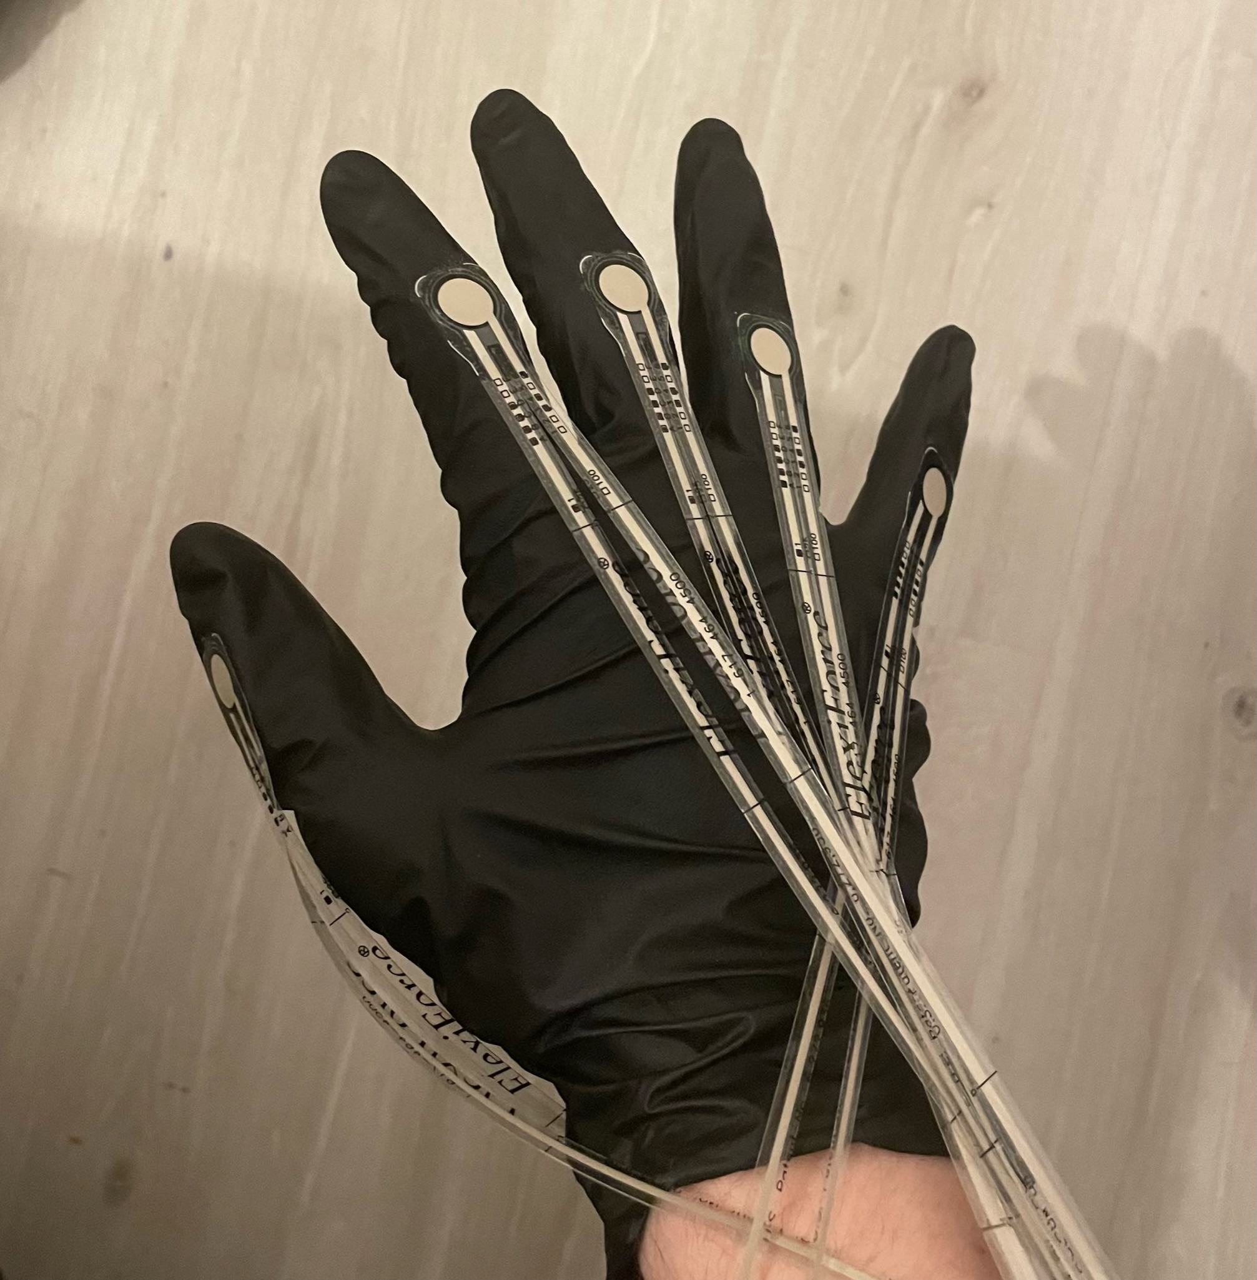
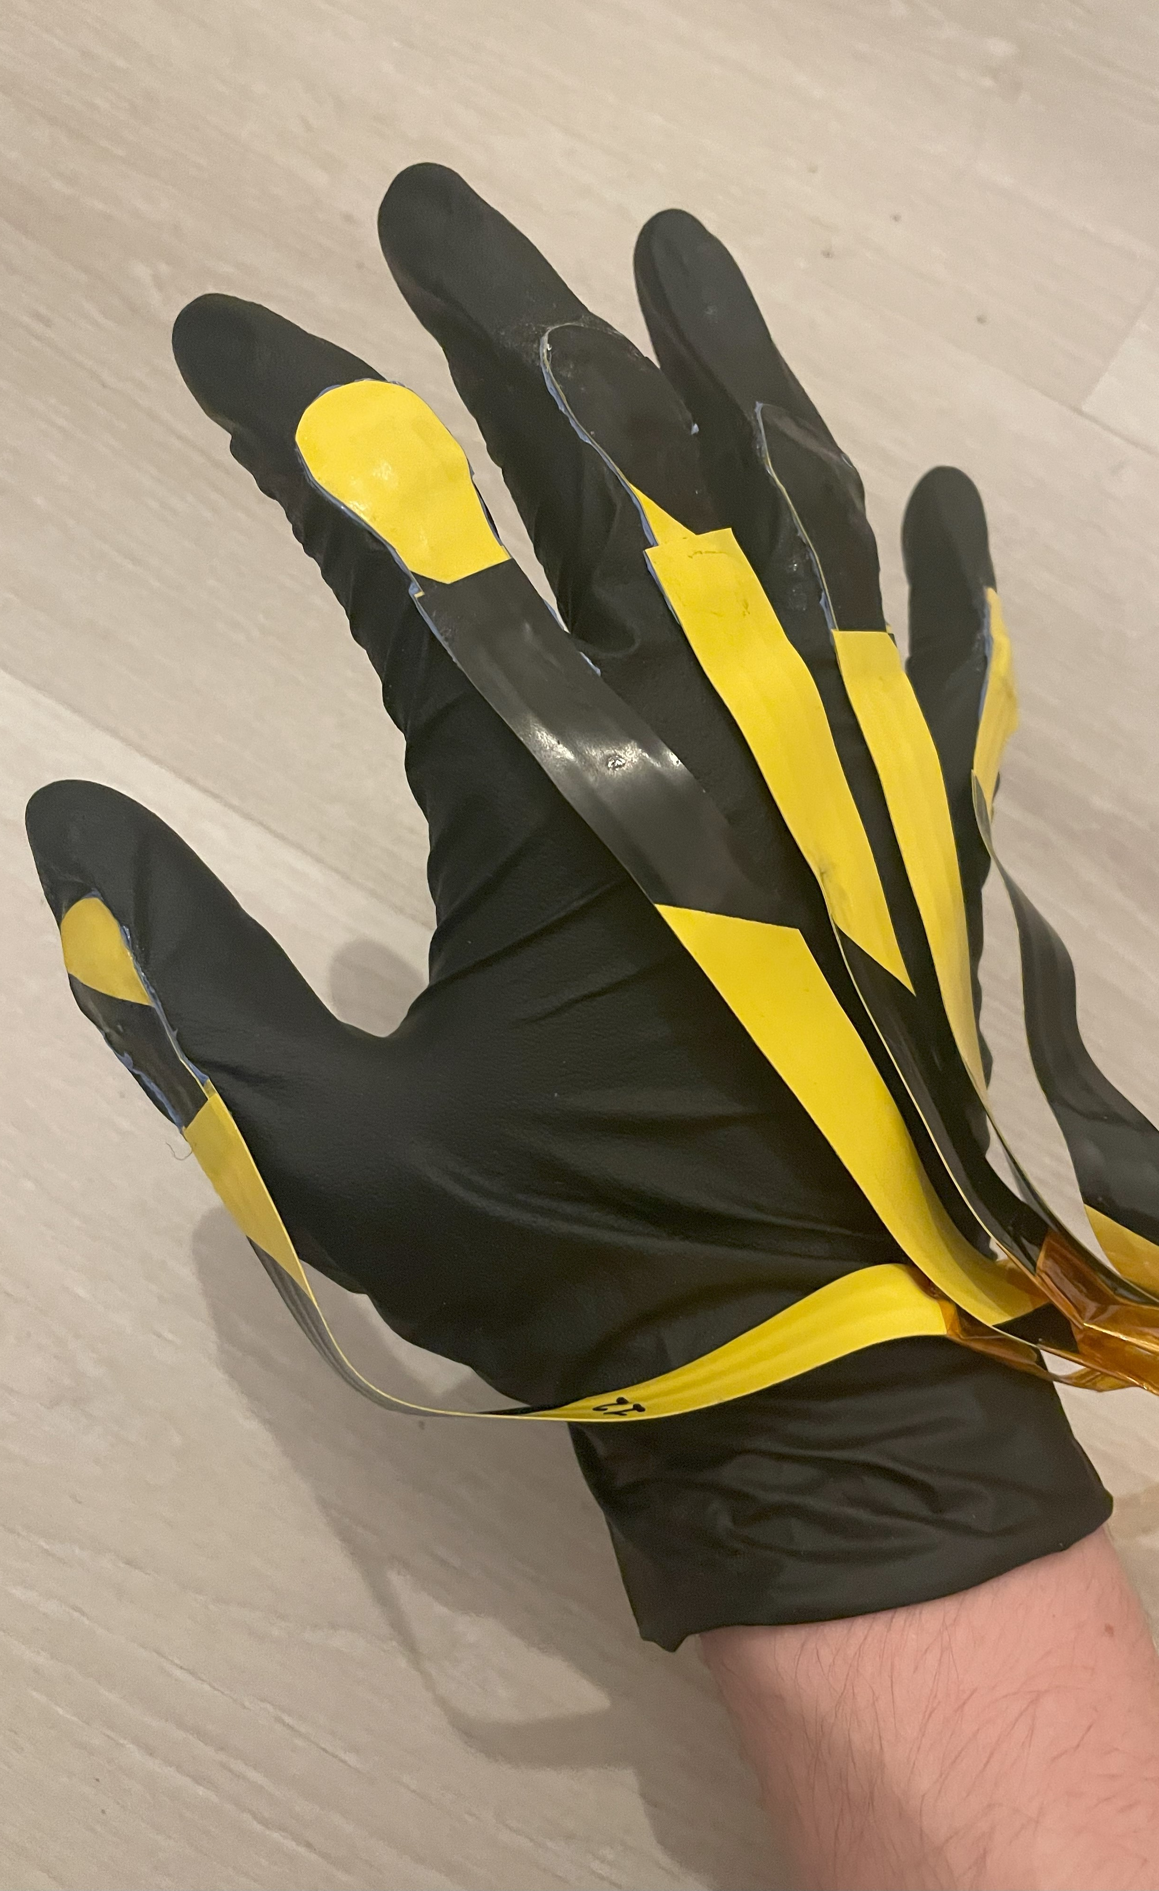
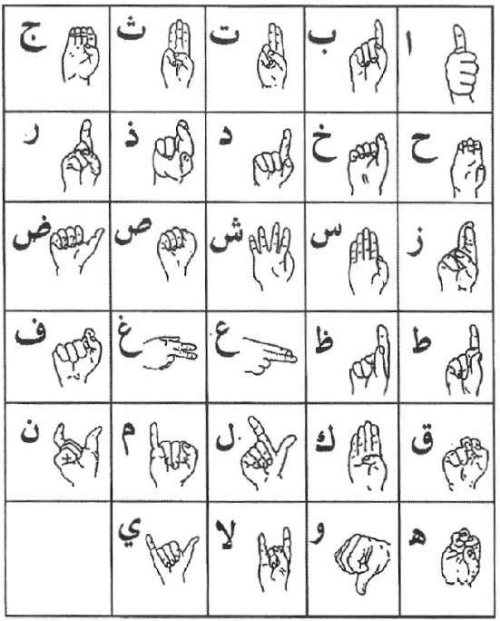
Machine Learning Procedure
Final Sensorised Gloves Used
Polyglotclub.com, 2023
Arabic Sign Language Alphabet
Deemah Alosail et al., 2023

Slide 7
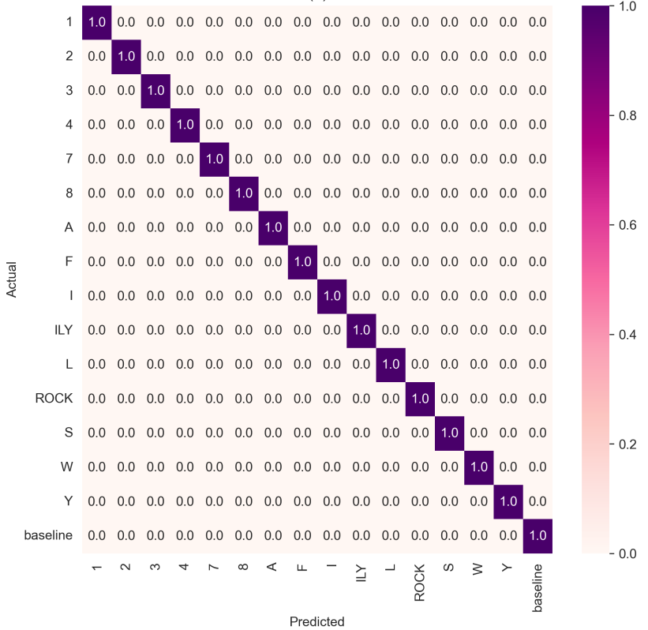
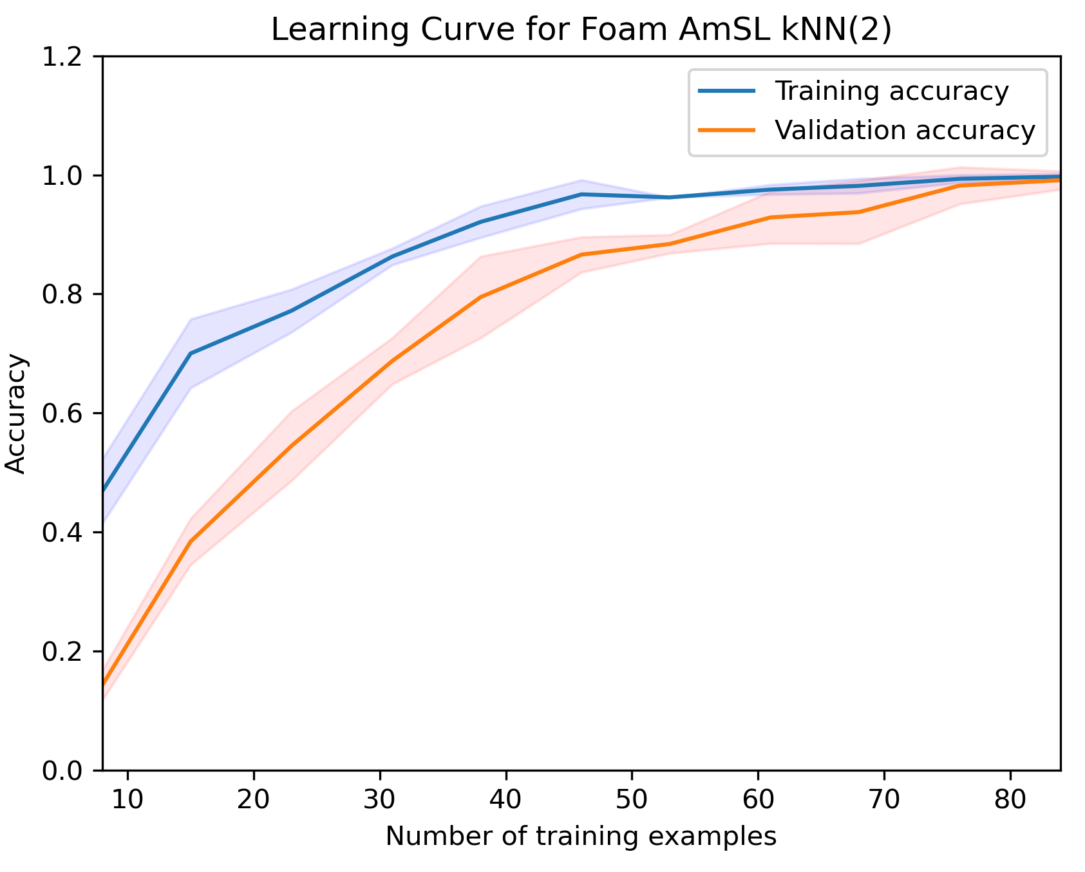
Machine Learning Results
Results for foam sensors on American Sign Language

Slide 8
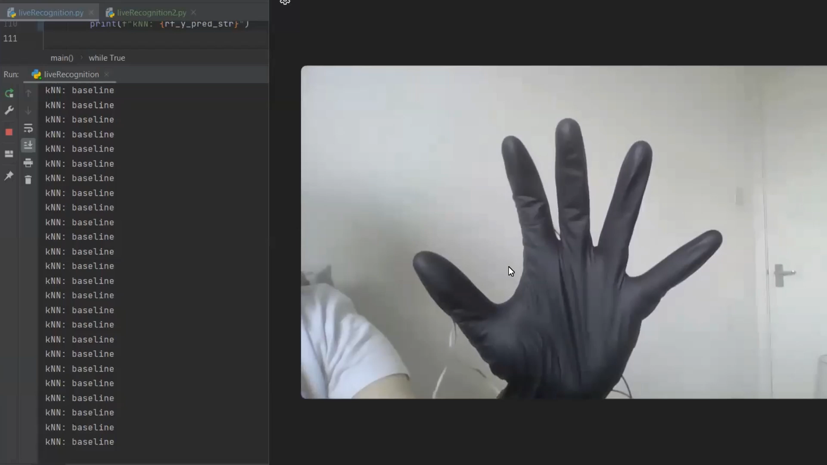
Live Gesture Recognition

Slide 9
Conclusion and Future Work
Main innovations
Demonstrated feasibility of using novel strain sensors in gesture recognition applications.
Sensors developed were cheap, reproducible, easy to fabricate, and thin for usability.
High classification accuracy obtained with well-fitted and generalized models, allowing success in live gesture recognition.
Future Directions
Biocompatibility tests for clinical applications.
Use of a wider range of sensors to detect more gestures.
Expansion of sign language database while pairing with a user interface for human-computer interaction.

Slide 10
References
‌Sundaram, S., Petr Kellnhofer, Li, Y., Zhu, J.-Y., Torralba, A. and Matusik, W. (2019). Learning the signatures of the human grasp using a scalable tactile glove. 569(7758), pp.698–702. doi: 10.1038/s41586-019-1234-z
Fadelli, I. (2021). WaveGlove: A glove with five inertial sensors for hand gesture recognition. Techxplore.com. Available at: https://techxplore.com/news/2021-06-waveglove-glove-inertial-sensors-gesture.html
Polyglotclub.com. (2023). American Sign Language: my experience. Available at: https://polyglotclub.com/wiki/Language/American-sign-language/Tips/My-Experience
Deemah Alosail, Hussa Aldolah, Alabdulwahab, L., Bashar, A. and Khan, M. (2023). Smart Glove for Bi-lingual Sign Language Recognition using Machine Learning. doi: 10.1109/idciot56793.2023.10053470
I, Toby Bunn, confirm that the work presented in this presentation is my own. Where information has been derived from other sources, I confirm that this has been indicated in the presentation.

